Slide 1
Module 10: Using Repository Variables
Analytics: Server Architect (Siebel 7.7)
Notes:
Time: Lecture: approximately 30 minutes; lab: see Lab Guide for timings.
Intent: This module explains variables.
Flow: Concepts are explained and then implementation steps are shown in the context of an ABC example.
Key Terms:
System session variable
Non-system session variable
Static repository variable
Dynamic repository variable
Initialization block
10

Slide 2

Module Objectives
After completing this module you will be able to:
  Describe session variables
  Describe repository variables
  Describe initialization blocks
  Implement a dynamic repository variable
Why you need to know:
  Variables allow you to incorporate flexibility into your model
Notes:
Each objective and “why you need to know” should be stated aloud.

Slide 3
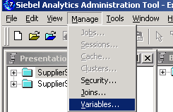
Variables
Contain values in memory that are used by the Siebel Analytics Server during its processing
Are created and managed using the Variable Manager feature in the Analytics Administration Tool
Consist of two types:
  Session variables
  Repository variables
Notes:
You can use variables in a repository to streamline administrative tasks and modify metadata content dynamically to adjust to a changing data environment. A repository variable has a single value at any point in time. Repository variables can be used instead of literals or constants in expression builders in the Administration Tool. The Siebel Analytics Server will substitute the value of the repository variable for the variable itself in the metadata. The Administration Tool includes a Variable Manager for defining variables. To access the Variable Manager, select Manage > Variables. The types of variables are defined on subsequent slides.
10

Slide 4
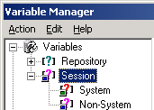
Session Variables
Persist only while a user’s session is active
Receive values when users establish their sessions
Come in two types:
  System
  Non-System
Notes:
Session variables are primarily used when authenticating users against external sources such as database tables or LDAP servers. If a user is authenticated successfully, session variables can be used to set filters and permissions for that session. A session is an instance of a user running the client application. The session starts when the application is started and ends when the application is exited. The types are defined on subsequent slides.

Slide 5
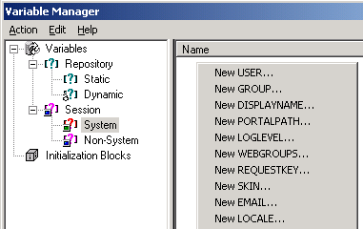
System Session Variables
Are predefined session variables that are used by the Siebel Analytics Server for specific purposes
Have reserved names, which cannot be used for other kinds of variables
  Example: USER holds the value the user entered for login name
Right-click for list
For complete definitions, see the Siebel Analytics Server Administration Guide.
Notes:
System session variables are session variables that the Siebel Analytics Server and Siebel Analytics Web Server use for specific purposes. System session variables have reserved names, that cannot be used for other kinds of variables. An example is USER, which holds the value the user entered as his or her logon name. Another example is GROUP, which contains the group that a user belongs to.
10

Slide 6
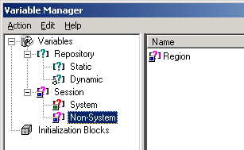
Non-System Session Variables
Are application-specific variables that are created by the implementation team
Example:
  Capture the user’s region and limit the records the user sees to only those for that region
Notes:
A common use for nonsystem session variables is setting user filters. For example, you could define a nonsystem variable called SalesRegion that would be initialized to the name of the user’s sales region. You could then set a security filter for all members of a group that would allow them to see only data pertinent to their region.

Slide 7
Repository Variables
Persist from the time the Siebel Analytics Server is started until it is shut down
Can be used instead of literals or constants in expression builders in the Administration Tool
  Siebel Analytics Server will substitute the value of the repository variable for the variable itself in the metadata
Come in two types:
  Static
  Dynamic
Notes:
A repository variable has a single value at any point in time. Repository variables can be used instead of literals or constants in expression builders in the Administration Tool. The Siebel Analytics Server will substitute the value of the repository variable for the variable itself in the metadata. There are two types of repository variables: static and dynamic. Repository variables are represented by a question mark icon. The types are defined on subsequent slides.
10

Slide 8
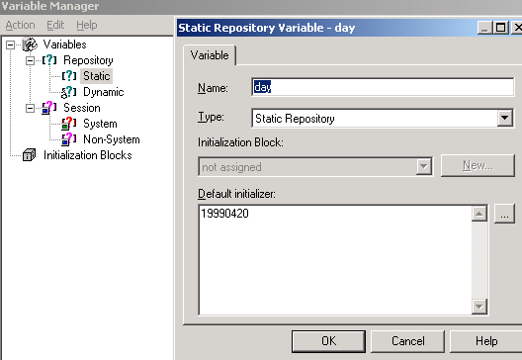
Static Repository Variables
Are repository variables whose values are constant and do not change while the Siebel Analytics Server is running
Values are initialized in the Variable dialog box
Static value
Notes:
The value of a static repository value is initialized in the Variable dialog box. This value persists, and does not change until a Siebel Analytics Server administrator decides to change it. Values are initialized once and remain constant. An example of this might be the last time the data was loaded (to represent how current the analytical information is).

Slide 9
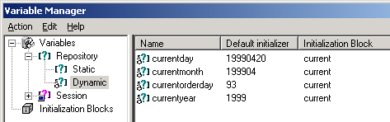
Dynamic Repository Variables
Are repository variables whose values change according to a refresh schedule
Values are initialized and refreshed using an initialization block
Notes:
You initialize dynamic repository variables in the same way as static variables, but the values are refreshed by data returned from queries. When defining a dynamic repository variable, you will create an initialization block or use a preexisting one that contains a SQL query. You will also set up a schedule that the Siebel Analytics Server will follow to execute the query and periodically refresh the value of the variable. When the value of a dynamic repository variable changes, all cache entries associated with a business model that reference the value of that variable will be purged automatically. Each query can refresh several variables—one variable for each column in the query. You schedule these queries to be executed by the Siebel Analytics Server.
10

Slide 10
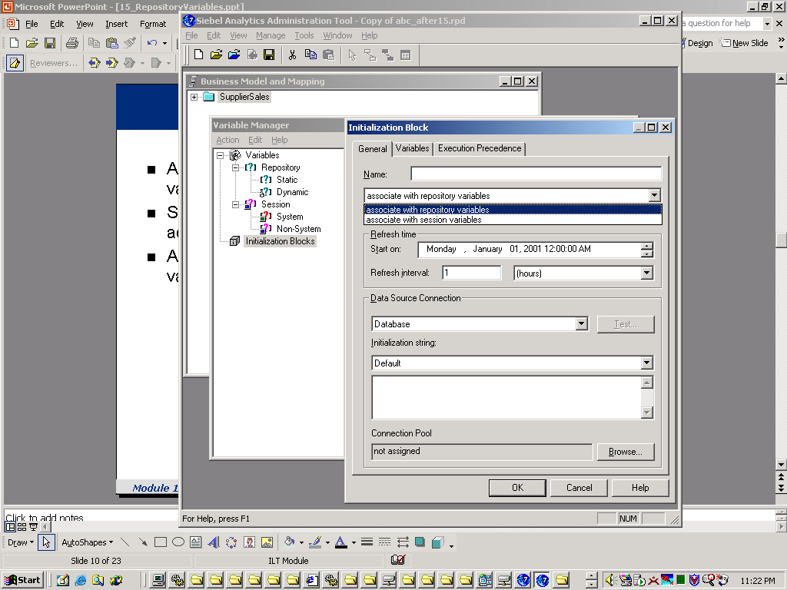
Initialization Blocks
Are used to initialize session variables and dynamic repository variables
Specify SQL to be run to populate one or more variables by accessing data sources
Are invoked at Siebel Analytics Server startup and periodically rerun to refresh values for dynamic variables according to an established schedule
New initialization block
Select type of variable
Notes:
Initialization blocks are used to initialize dynamic repository variables, system session variables, and nonsystem session variables. For example, the NQ_SYSTEM initialization block is used to refresh system session variables. An initialization block contains the SQL that will be executed to initialize or refresh the variables associated with that block. The SQL must reference physical tables that can be accessed using the connection pool specified in the Connection Pool field in the Initialization Block dialog box.

Slide 11
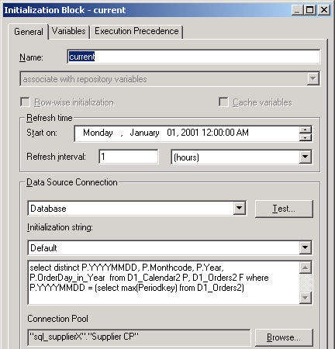
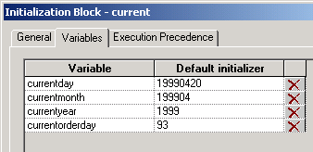
Initialization Blocks Example
Determine the latest date contained in the source data and store it in variables
Variables populated by this initialization block
SQL to initialize the variables in order—select list matches variable sequence
Data source to run the SQL against
Notes:
Notice that the initialization block works together with the variables. The block defines how the variables get their values and what the refresh schedule is. Notice also that the order in the select list of the statement controls what values are assigned to what variables. The first item in the select list is the value for the first variable, and so on. The data source references a connection pool defined in the physical layer of the repository.
10

Slide 12
Initialization Blocks Example Continued
Set the refresh interval to determine when to reissue the SQL to update the variable values
Rerun the SQL statement every hour
Notes:
When the refresh interval is reached, rerun the SQL to reset the values for the variables.

Slide 13
ABC Example
Use a variable to dynamically determine which set of customer data is in which partition and use it to specify the fragmentation content instead of hard-coding it as A – M and N – Z
Fragment 1 will contain half the data
Names will start with A but end is unknown
NewKey | Name
1000 | Clifton Lunch
Fragment 2 will contain the remaining data
NewKey | Name
1002 | Tong’s Wok
Names will end with Z but start is unknown
Notes:
This example assumes that the source of data is refreshed periodically and, therefore, the contents in each fragment may be different.
10

Slide 14
Implementation Steps
0/6
Open the Variable Manager
Create an initialization block
Specify the initialization value
Create the variable
Use the variable
Test
Notes:
This is a structuring slide. Do not teach the steps or concepts here because the following slides cover them in detail. Provide a high-level description of what will be discussed.

Slide 15
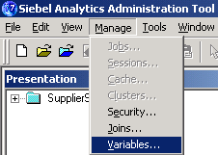
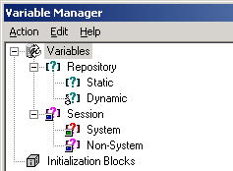
1. Open the Variable Manager
1/6
From the Analytics Administration Tool, select Manage > Variables
Notes:
10

Slide 16
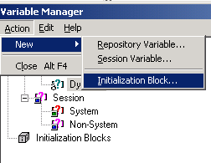
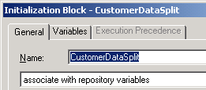
2. Create an Initialization Block
2/6
From the Variable Manager, select Action > New > Initialization Block
Enter a name for the initialization block

Slide 17
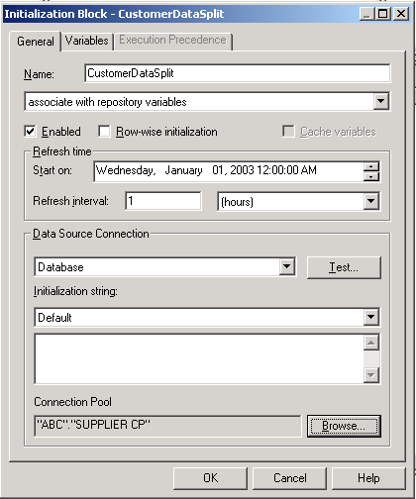
3. Specify the Initialization Value
3/6
Select the connection pool of the data source to query from
Select the source
Notes:
In this example, the connection pool is SUPPLIER CP, the connection pool for the supplier2 database.
10

Slide 18
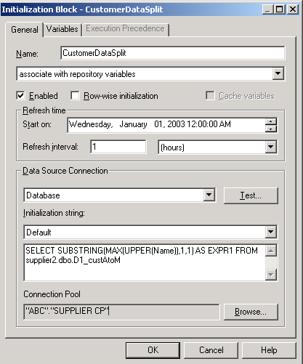
3. Specify the Initialization Value Continued
3/6
Enter the SQL to establish the values
Selects the maximum customer name and extracts the first letter
Notes:
You can enter different SQL statements for different database platforms. The initialization value must include a "default" SQL.

Slide 19
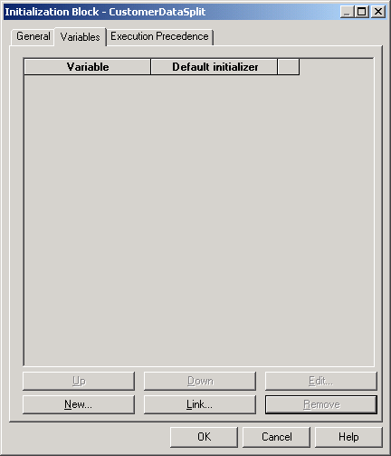
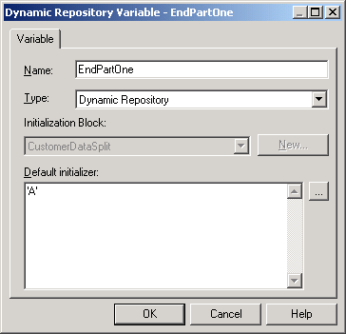
4. Create the Variable
4/6
Click the Variable tab and click New to create a new variable associated with the initialization block
Enter a default literal value
Notes:
For repository variables, when you open a repository in online mode, the value shown in the Default initializer column of the Initialization Block Variables tab is the current value of that variable as known to the Siebel Analytics Server.
10

Slide 20
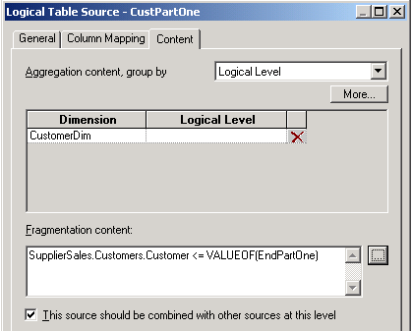
5. Use the Variable
5/6
Use VALUEOF(“VariableName”) to use the value of the variable in an expression
Picking the variable in the expression builder will add the VALUEOF function automatically
Notes:
Note that you could also create a logical column and use the VALUEOF operator. Exposing it would allow users to access a dynamic column.

Slide 21
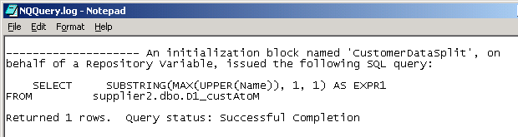
6. Test
6/6
Verify that the variable gets initialized and used properly
  SQL for the initialization block is recorded in the log file
Notes:
Repository variables run under Administrator. The Administrator logging level must be > 0 to see these in the log.
10

Slide 22
Summary
This module showed you how to:
  Describe session variables
  Describe repository variables
  Describe initialization blocks
  Implement a dynamic repository variable
Notes:
Review Questions:
Question: You can rename a system variable. True or false?
Answer: False
Question: You must create a separate initialization block for each variable. True or false?
Answer: False
Question: Static repository variables are refreshed according to a schedule set in the initialization block. True or false?
Answer: False; dynamic variables are.

Slide 23
Lab
In the lab you will:
  Create and use a dynamic repository variable
Notes:
Labs and Troubleshooting:
See Lab Guide for details.
The lab is pretty straightforward. Possible problems may arise regarding syntax in the initialization block and in the fragmentation content specification.
10

